Slide 1
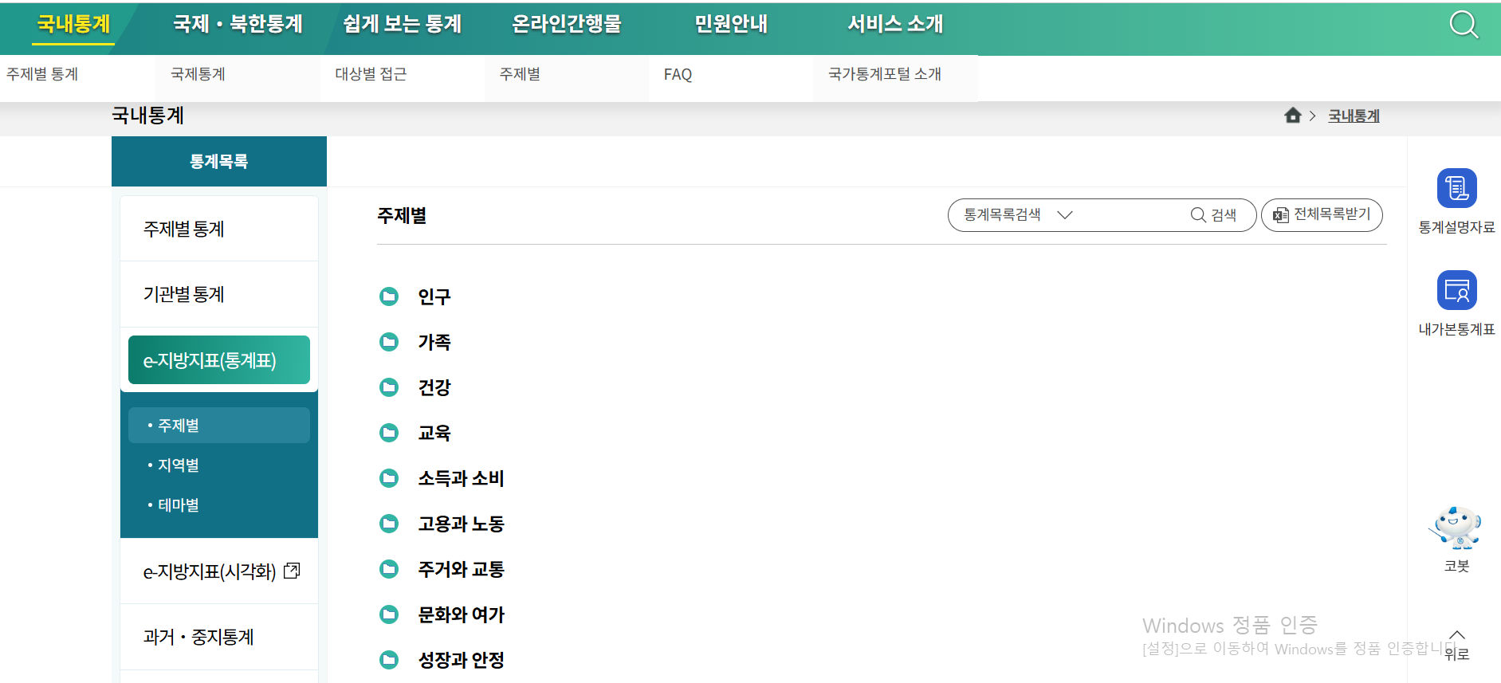

Slide 2
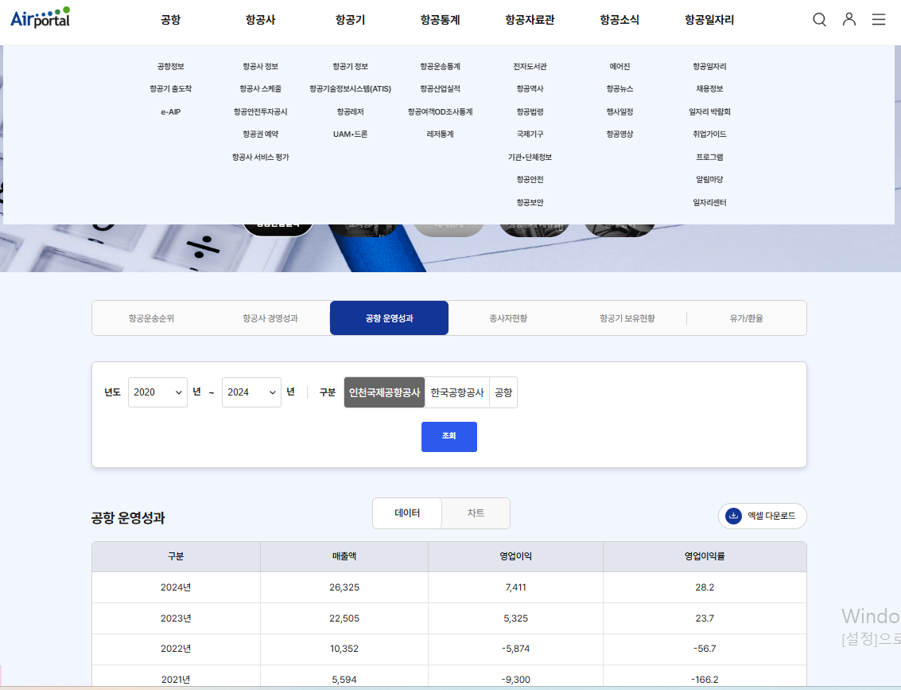
https://www.airportal.go.kr/stats/transport/dashboard.do

Slide 3
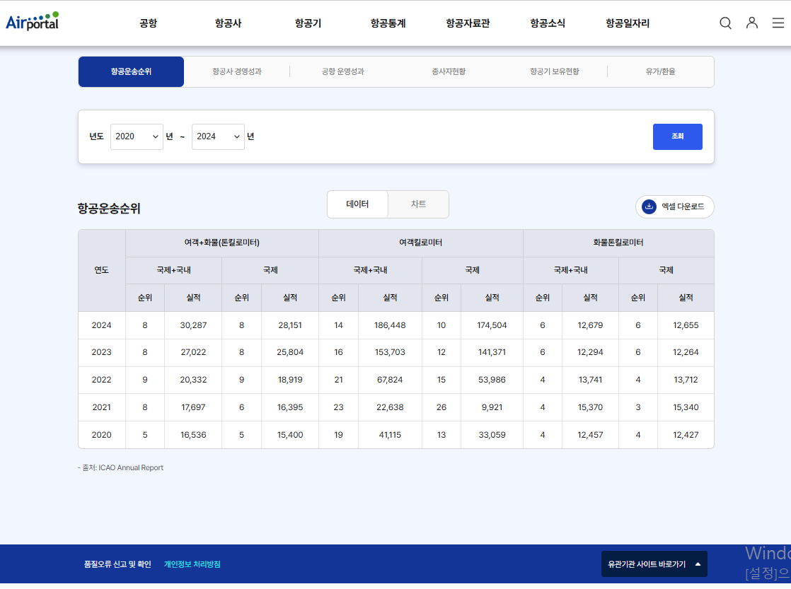

Slide 4
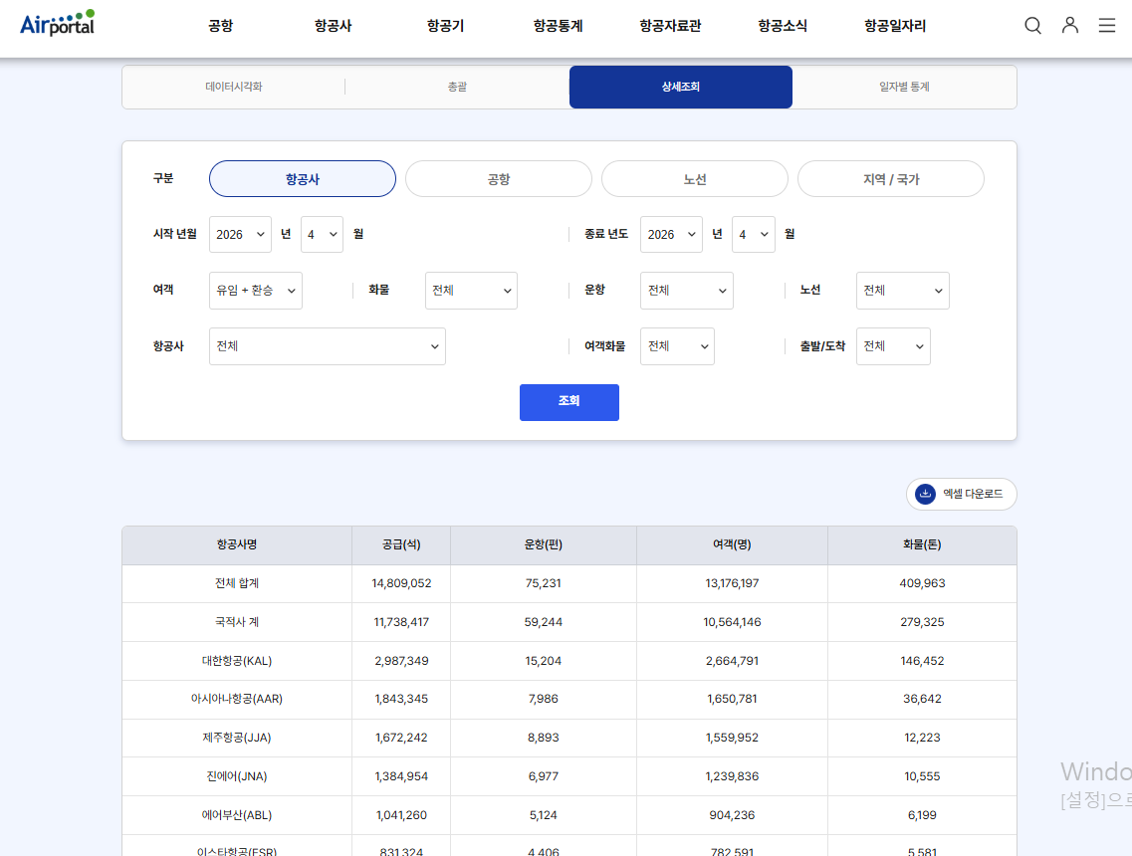

Slide 5
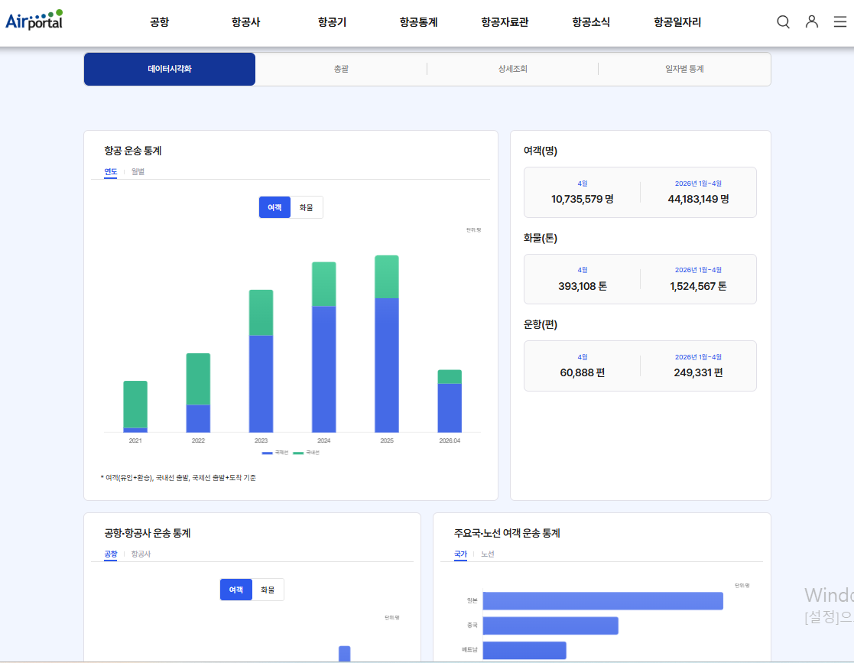

Slide 6
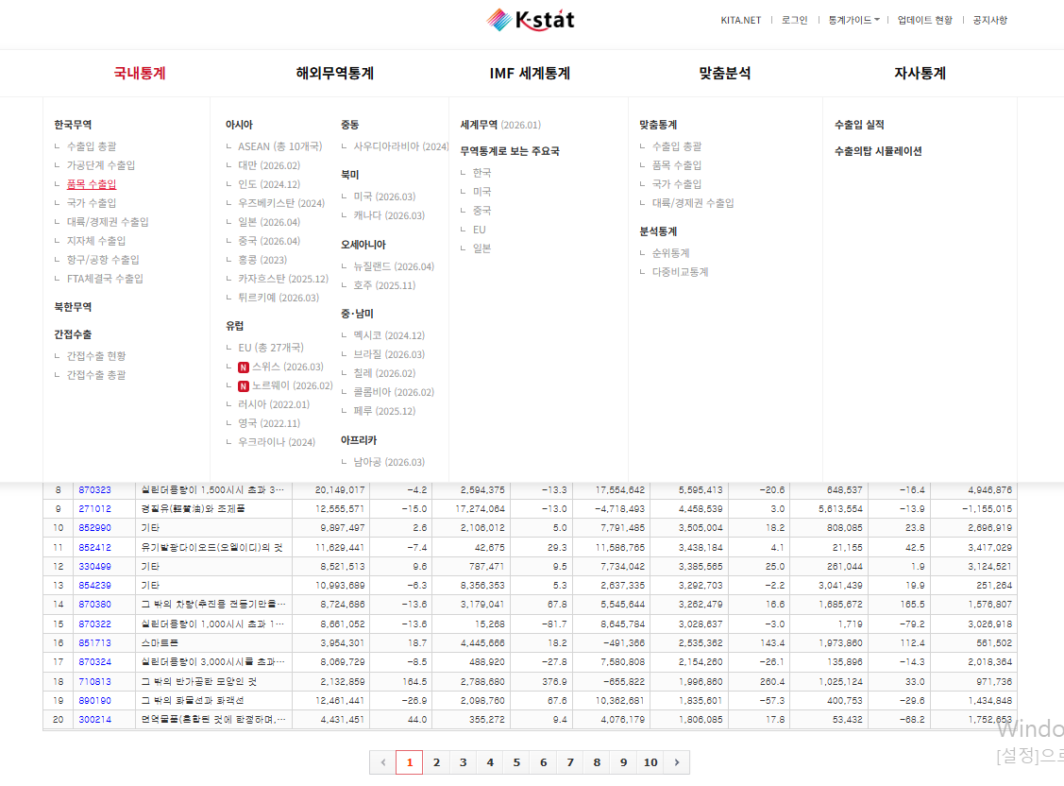
https://stat.kita.net/stat/kts/pum/ItemImpExpList.screen#

Slide 7
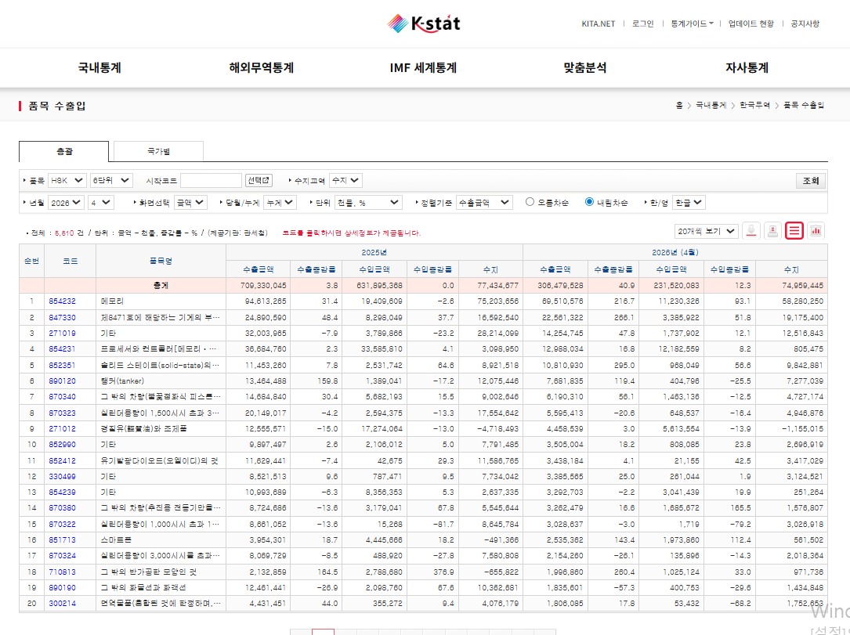

Slide 8
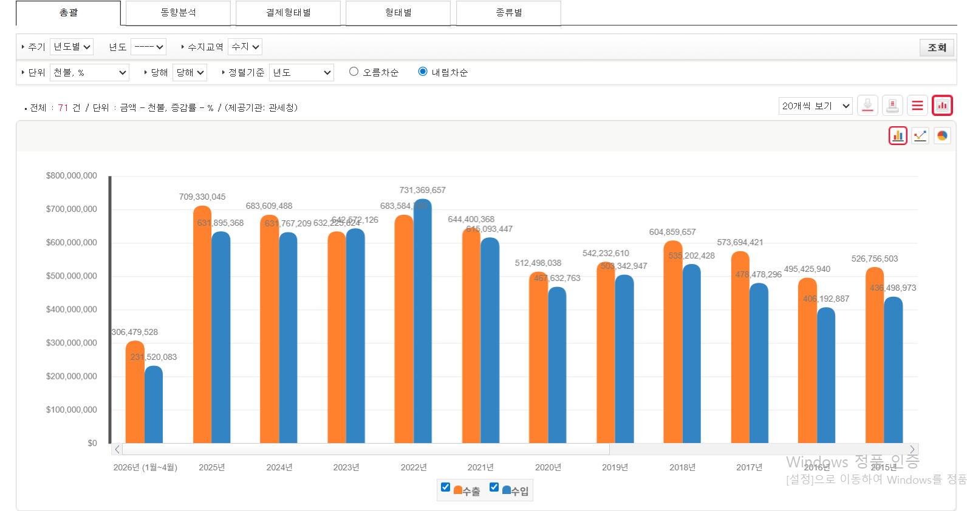

Slide 9
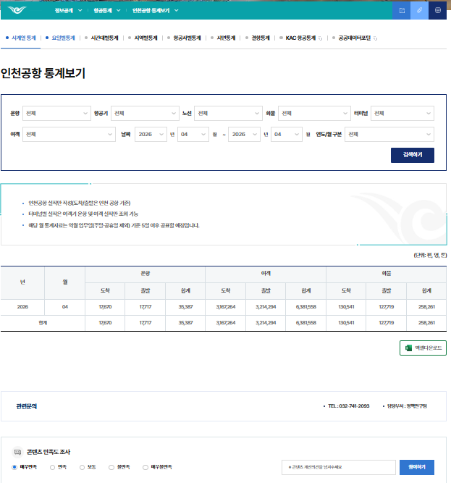
https://www.airport.kr/co_ko/651/subview.do

Slide 10
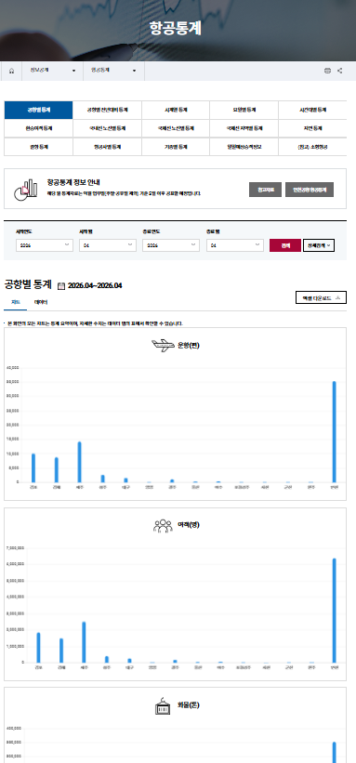
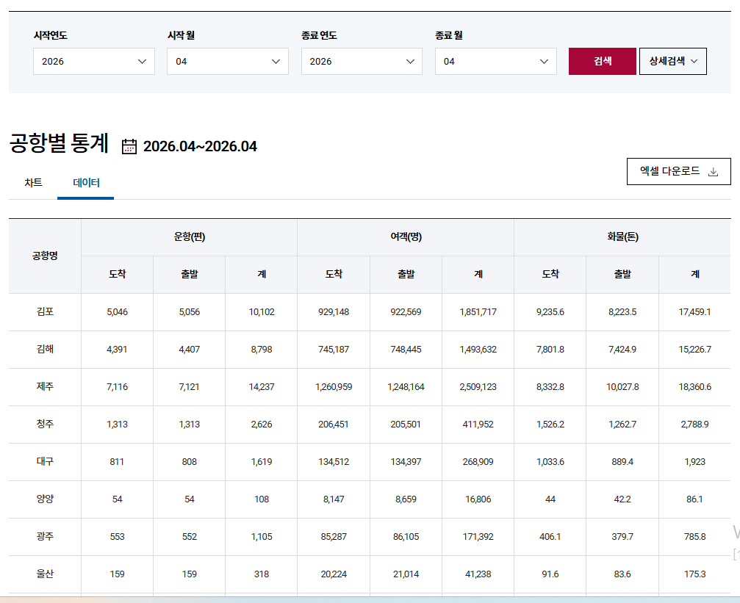
https://www.airport.co.kr/www/cms/frCon/index.do?MENU_ID=1250#none

